Slide 1

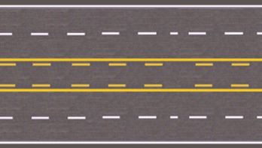


Module 2.3.1
Traffic Control and Laws
Roadway Markings
Montana Teen Driver Education and Training
Notes:
Roadway markings and traffic control devices instruct the driver where and what a driver is to do while driving. The follow module will help you understand what the signs and roadway markings are telling you.

Slide 2
Objectives
Understand need and purpose for traffic control signs, signals and road markings.
List and describe signs, signals and road markings.
Describe appropriate driver responses to signs, signals and road markings.
Apply traffic laws for operating a vehicle on public streets and highways.

Slide 3
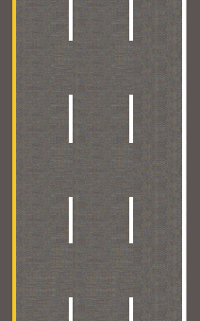
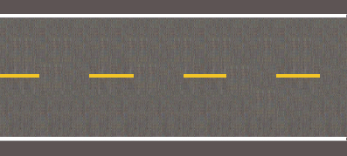
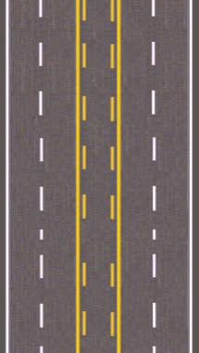
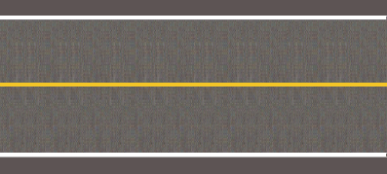
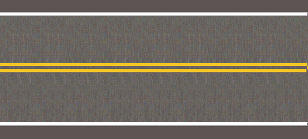
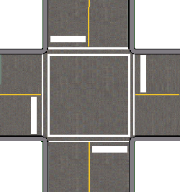
Pavement Markings
Multi-lane
Left-turn-only lane
Two-lane rural
ONE Way
Stop lines &
crosswalks
Notes:
For more information about Montana Pavement markings refer to the most current Montana Driver’s Manual.
Pavement markings come in two colors.
White lines separate traffic going in the same direction. Can be found on one-way streets, right edge of roadway, and marking crosswalks, bike lanes, and stop lines.
White lines also act as barrier lines, stop lines and cross walk lines. More on that later.
Yellow lines are found on the left and separate traffic going in opposite directions or mark the left edge of a lane.
What is happening if you are driving and the yellow line on the right?

Slide 4
Roadway markings
Where you can go and
what you can do
Designate lanes
Direct traffic
Warn of hazards
Signal permission to pass
Notes:
Even though these lines are shown as white, we know that they will be different colors.
As you click through this slide arrows will appear and disappear pointing to various lines. Students should be asked the following question:
What is this line, what color is this line and what does it instruct the driver to do?

Slide 5
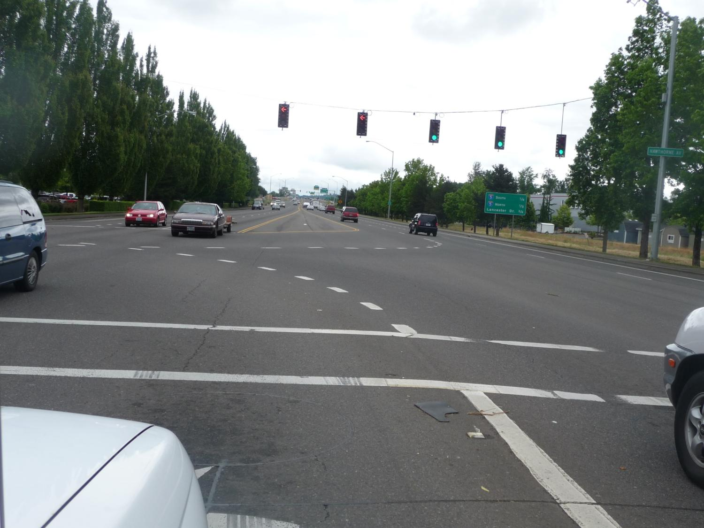
These white dotted lines separate turning paths.
AVOID CONFLICTS! DO NOT CROSS!
Notes:
What does the white dashed line tell the driver to do?
Can you change lanes during this maneuver?
Even though the line is there sometimes other drivers don’t follow its instruction. What should you watch for as you make this turn?

Slide 6
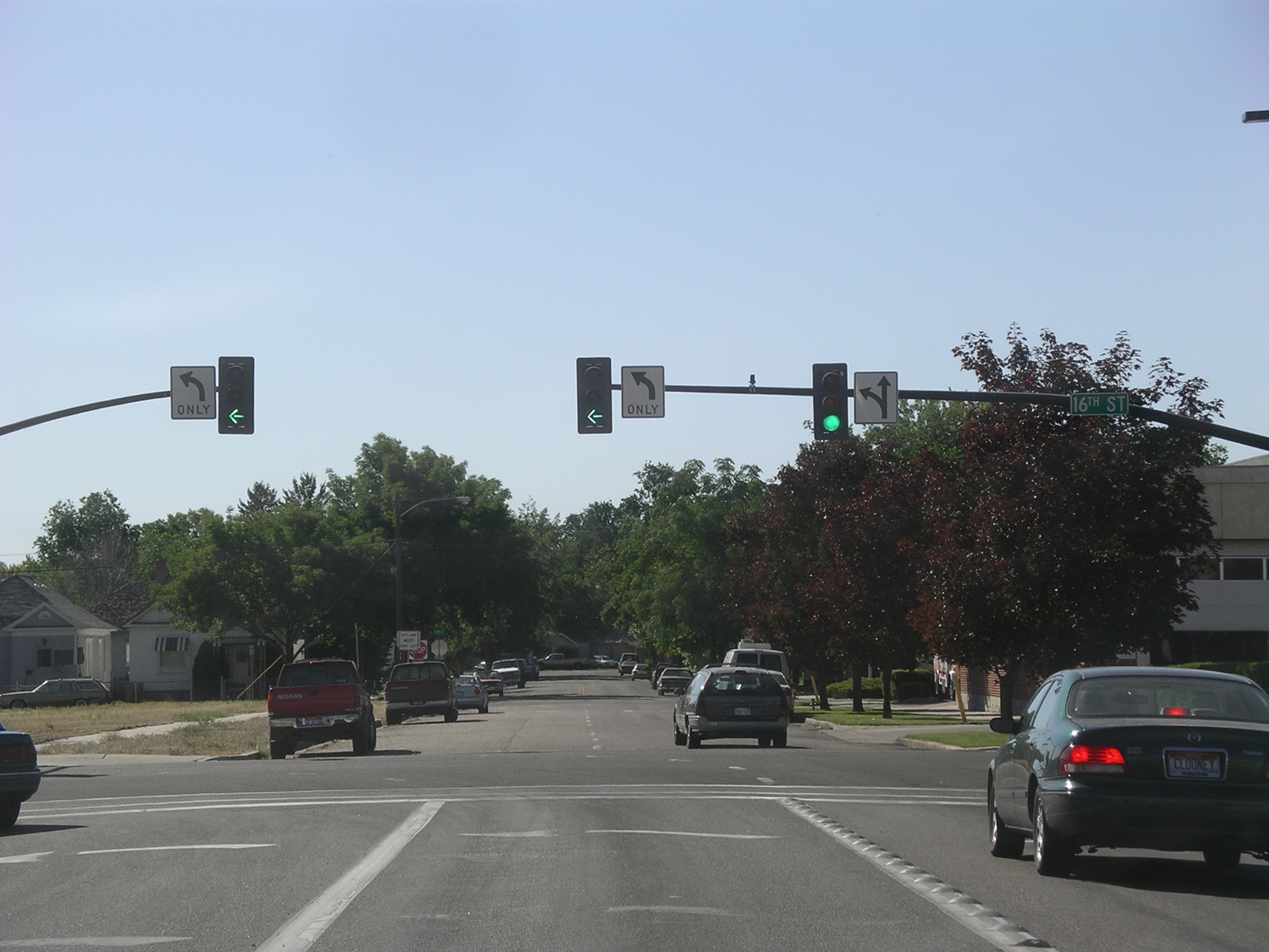
Solid white lane lines are barriers
No crossing is allowed
Notes:
Notice the two solid lines marking your lane. One also has bumps on it. These are called barrier lines and it is illegal to cross them.
What actions are required at this traffic signal?
What pavement markings and signs tell you that?

Slide 7
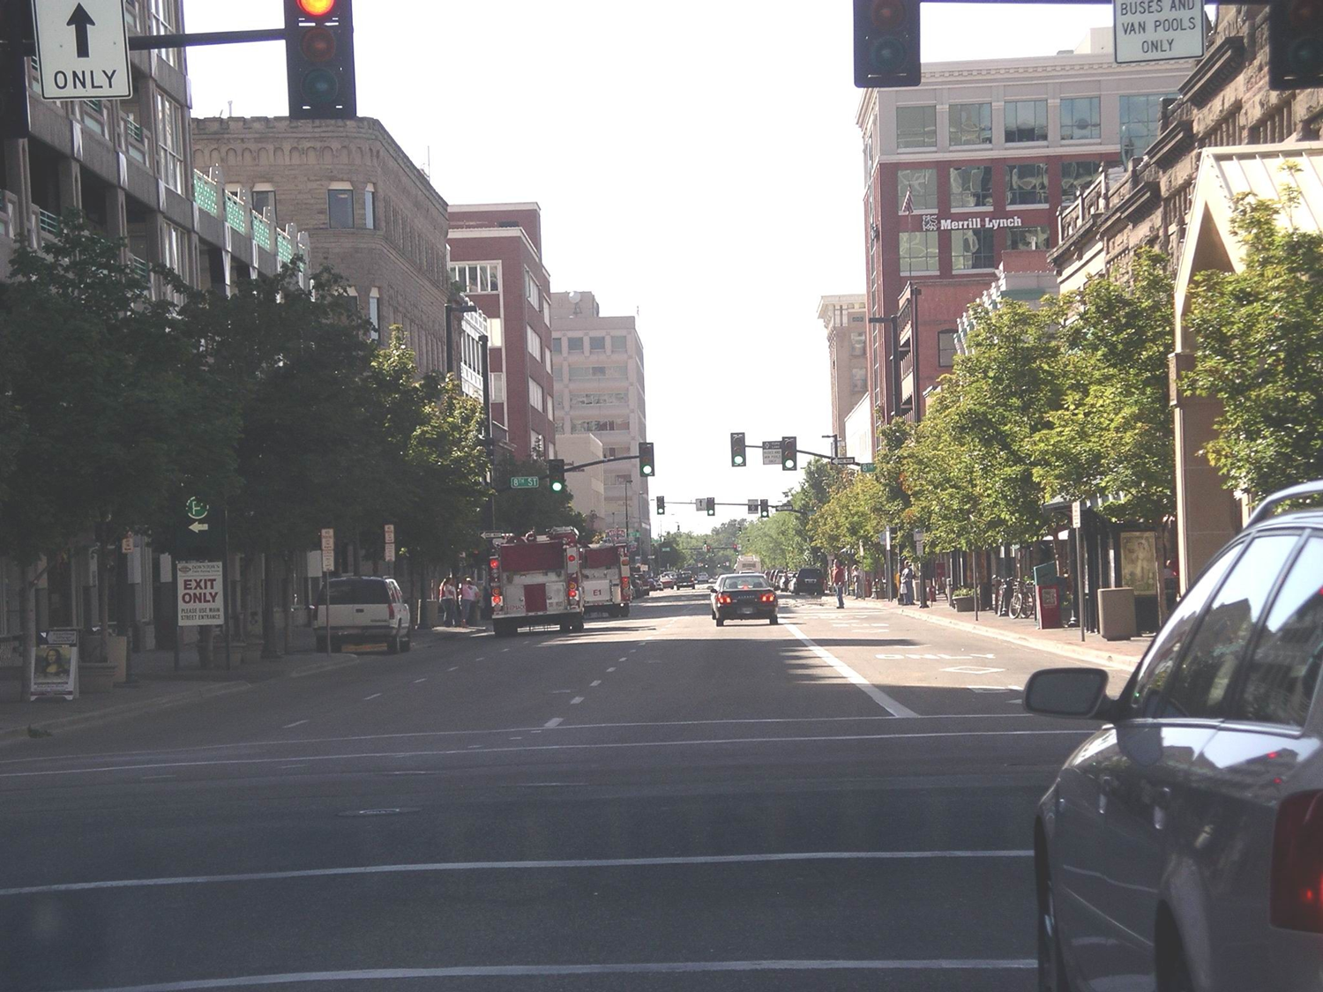
White lines separate lanes of traffic
moving in which direction?
Notes:
Road markings on this street give you clues on what you can do.
What kind of street is this?
There are two sets of dashed lines and one solid barrier line. There is also a diamond shape on the road in the right lane. Who can drive in the far right lane?

Slide 8
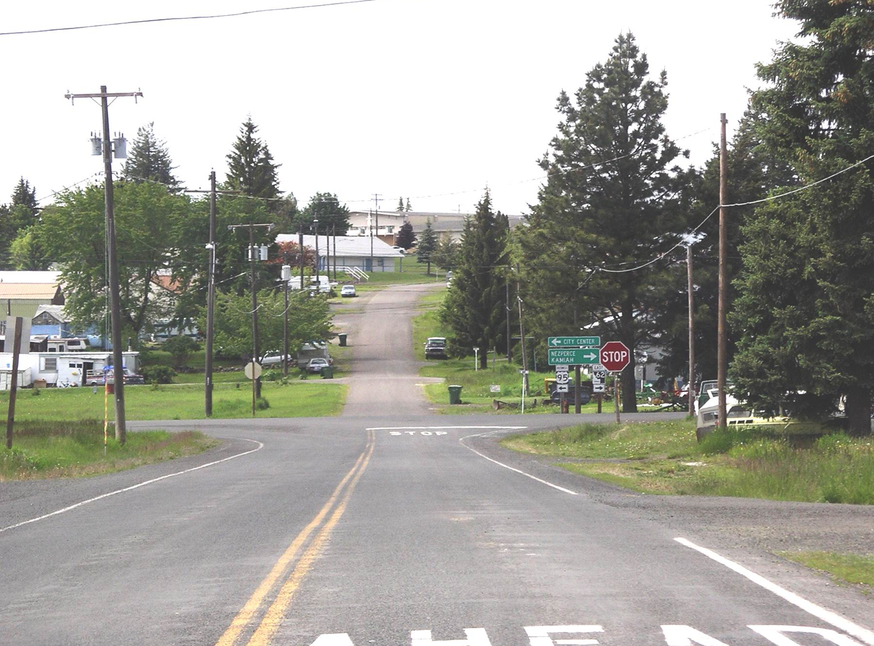
Stop Line
Legal stop location is before this line
Notes:
How many intersections are here?
Stop signs tell you what to do.
Lines tell you where to stop.
Where are you supposed to stop at this intersection?

Slide 9
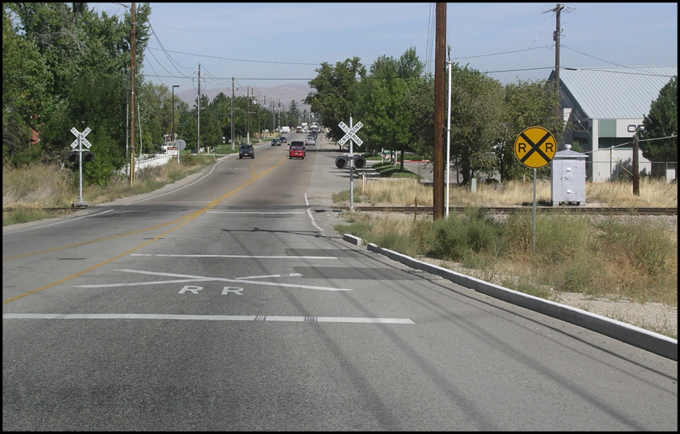
If the signals are flashing where are
you supposed to stop?
Notes:
If the signals were flashing where are you supposed to stop?
Is it legal to cross the tracks when the lights are flashing?
Who must yield at this intersection?

Slide 10
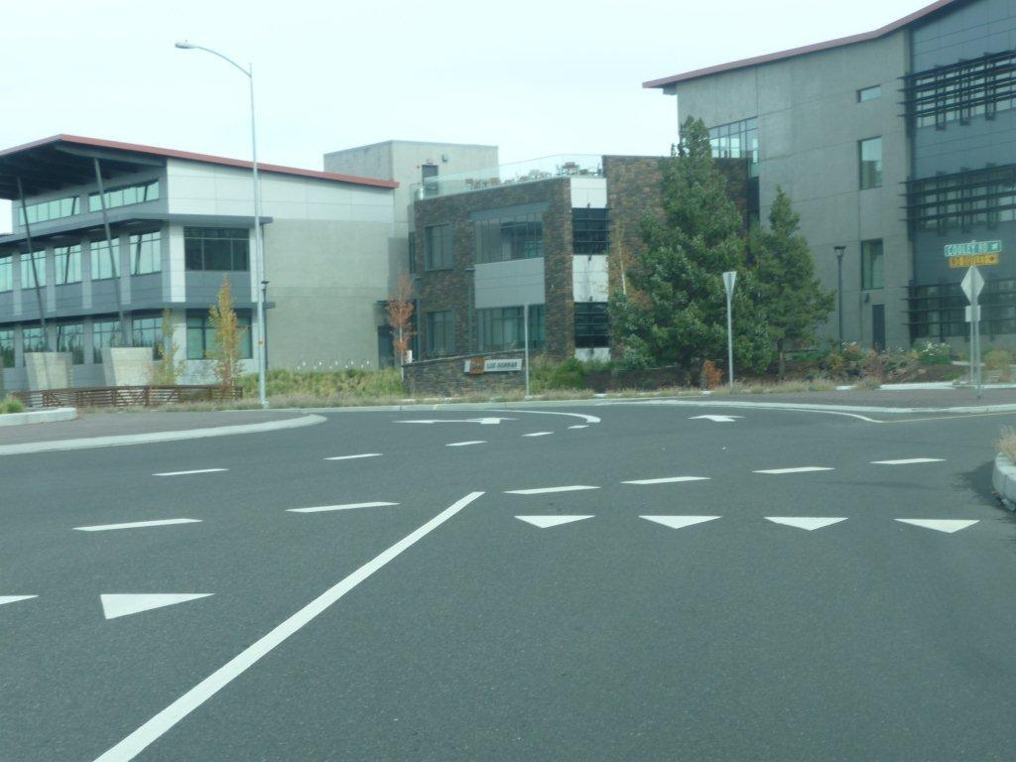
Yield Line (shark tooth)
Legal yield location is before this line.
Notes:
These triangle markings are becoming more common before crosswalks and roundabouts.
They serve two purposes:
The first is to tell you that you must yield to pedestrians and prior to entering the roundabout.
The second is to tell you where to stop when you are yielding to another car or pedestrian.

Slide 11
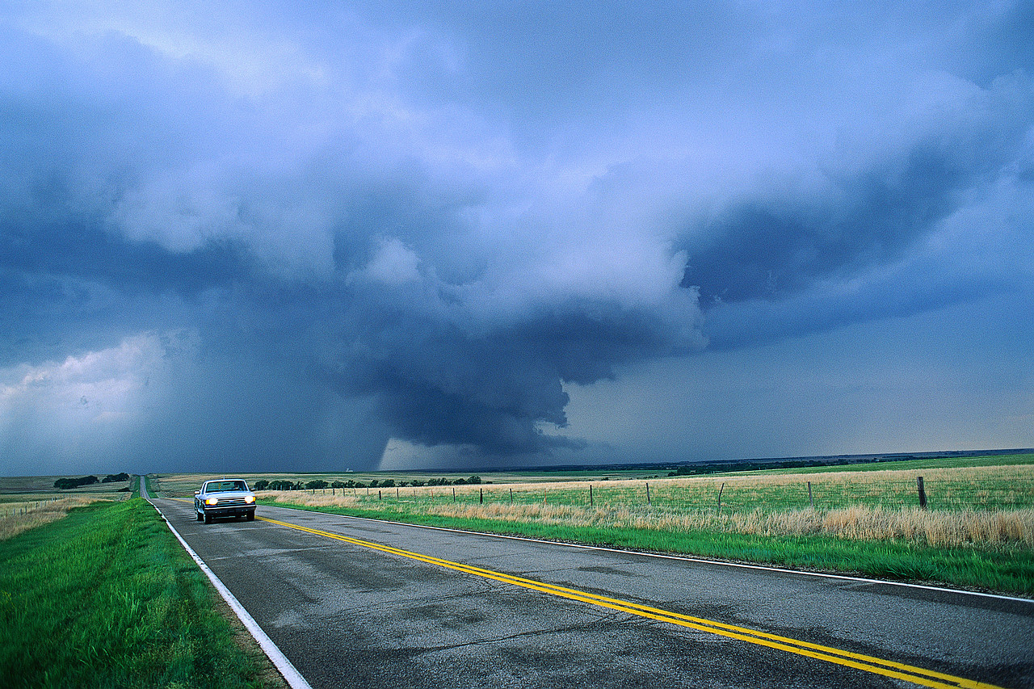
Narrow solid white lines mark
the right edge of the roadway
Notes:
On the right edge of a highway the solid white lines help keep you in your lane, especially at night. If you have low visibility due to fog or snow, keeping your eye on the white line will keep you on the road.

Slide 12
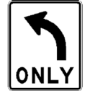
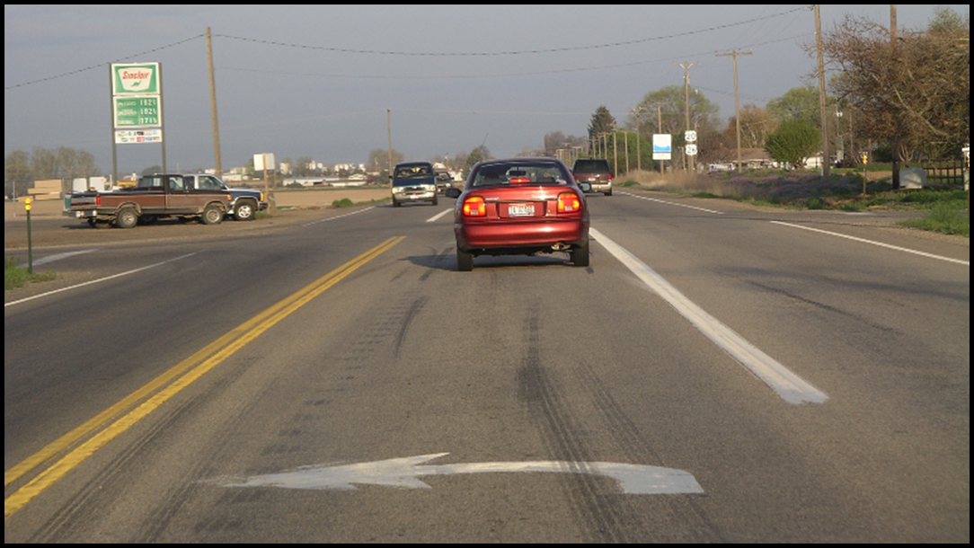
Left-Turn Lane
Notes:
note the use of the left-turn lane by the red car.

Slide 13
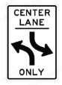
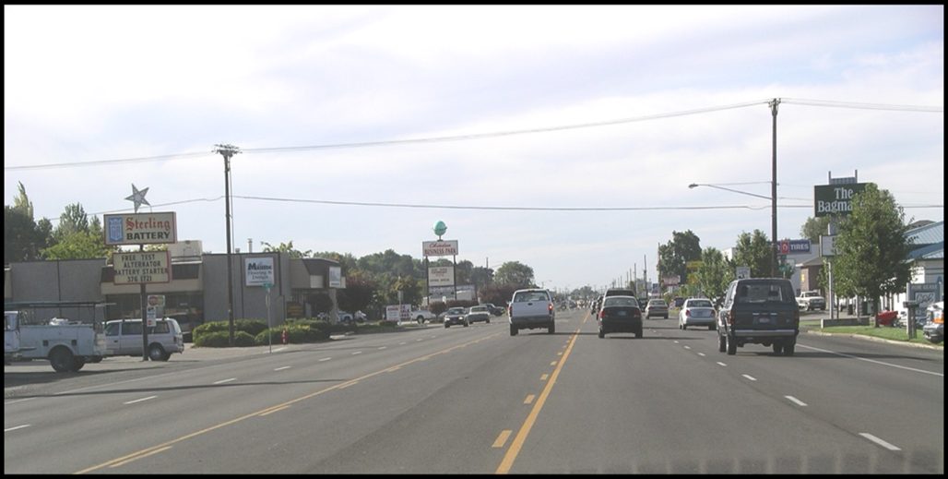
Shared Left-Turn Lane
Notes:
In this series of two images, note the use of the shared left-turn lane by the white truck in this slide and the driver’s view in the next slide.

Slide 14
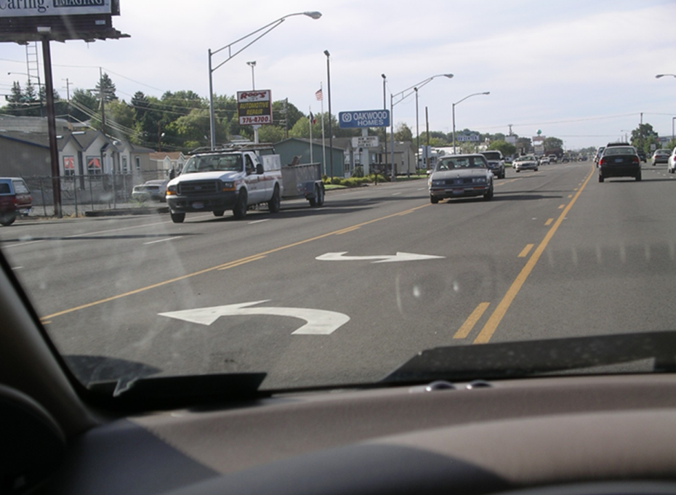
Notes:
Another view of a shared left-turn lane.

Slide 15
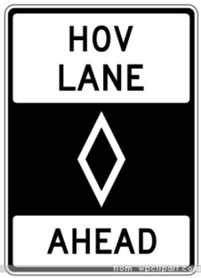
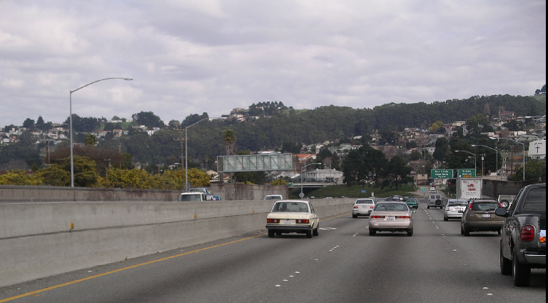
Carpool Lane Marking
Diamond Shape Marking
Broken white lines – crossing is allowed
Notes:
Under what conditions is it legal to drive in the HOV lane?
What does HOV mean? High Occupancy Vehicle: meaning two or more occupants per car.

Slide 16
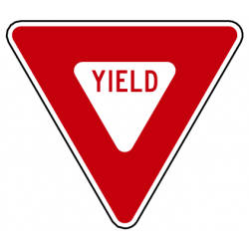
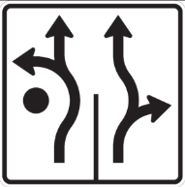

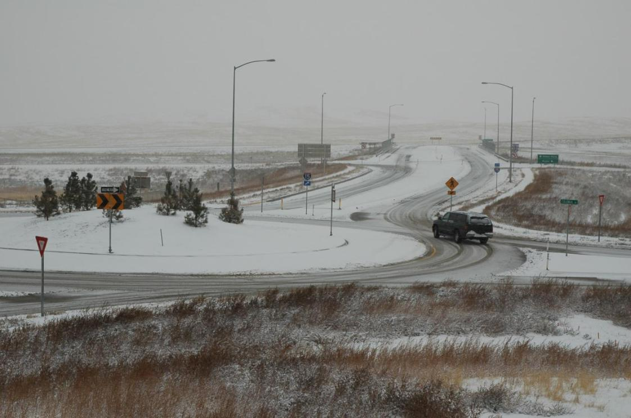
Roundabouts
Notes:
Good habits for Roundabouts
See the yield sign on approach
Slow, search for pedestrians, bicyclists
Stop only if necessary
Yield to traffic in the circle
Select a safe gap when entering the circle
When traveling in the circle, yield to traffic attempting to leave
Signal your exit
Search for pedestrians and bicyclists
Rule of Thumb
Yield on the entrance
Signal your exit

Slide 17
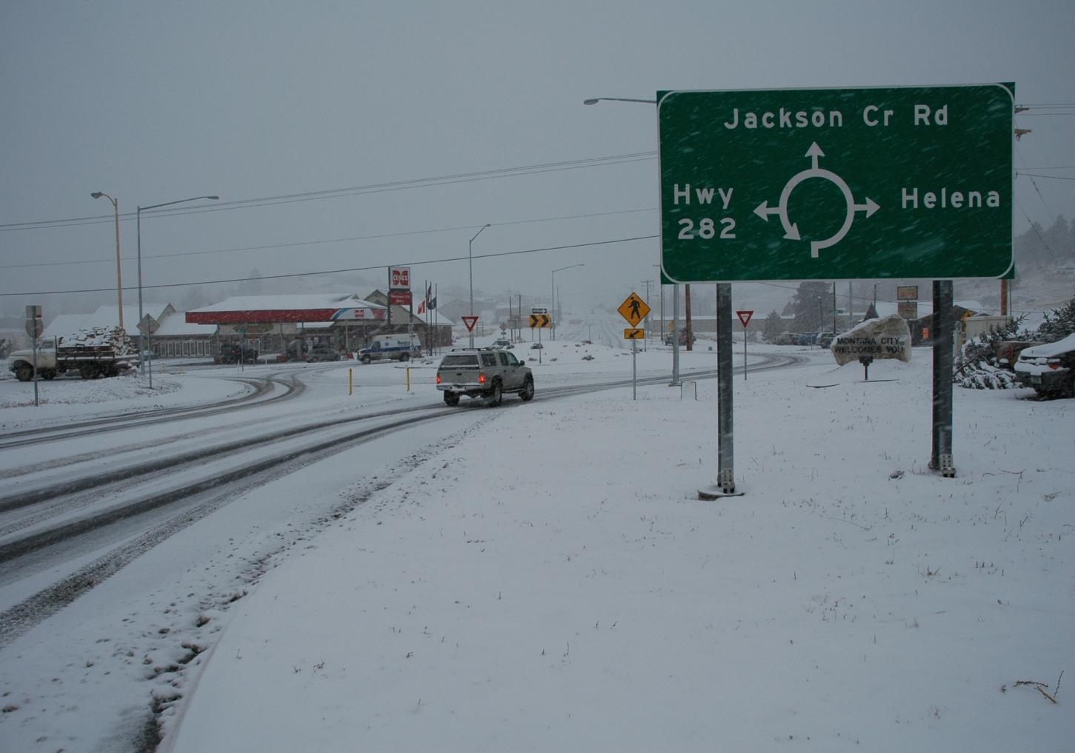
Notes:
If I want to go to Helena, where should I exit the roundabout?
Is it legal to use the roundabout to complete a U-turn? How should I do that?
If I wanted to go to Hwy 282, where should I exit the roundabout?

Slide 18
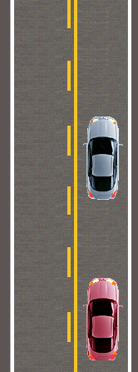
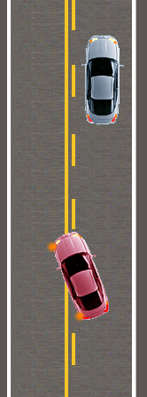
Passing/No Passing Road Markings
Notes:
In the diagram on the left, is it legal for the red car to pass the silver car? Why or why not?
How about the diagram on the right? What makes it legal for the red car to pass?
Solid yellow lines mean that it is unsafe to pass. Where would you find these lines?

Slide 19
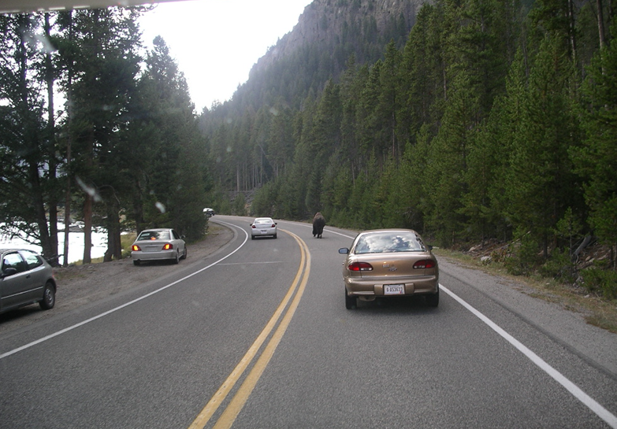
Yellow lines separate traffic moving in what direction?
Drive on which side of yellow lines?
Notes:
This car is passing in a no-passing zone. Why is it OK to pass here?
What should you consider when making this pass?
Speed, line of sight, which direction the buffalo is moving, are there other buffalo in the trees?

Slide 20
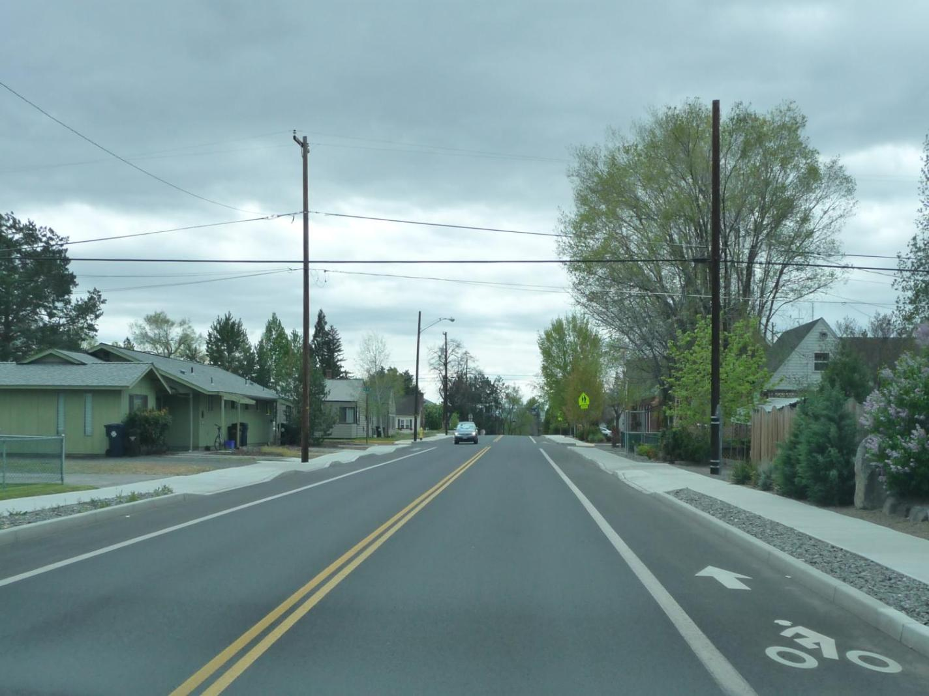
Turning left across solid double
yellow lines IS ALLOWED
Notes:
Your driveway is on the left. Is it legal to cross the double yellow line to turn into your driveway? If so, what must you do?
MCA 61-8-238 Driving on roadways laned for traffic. (4) A person may turn a vehicle left across a lane marked with two yellow lines into a public or private parking lot, private road, private driveway, or roadway if the turn can be may safely and if the person does no hinder the flow of oncoming traffic.

Slide 21
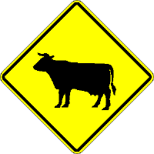

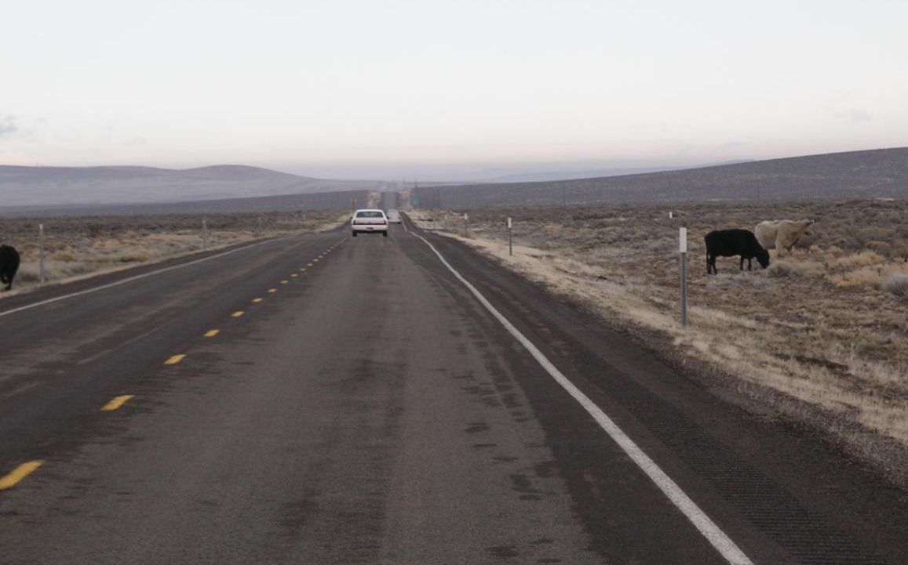
Open Range Law
Broken yellow lines: passing IS ALLOWED
Notes:
Open range means all unenclosed lands outside of cities, villages and herd districts, upon which cattle by custom, license, lease, or permit, are grazed or permitted to roam
Fences do not void the open range law
The owner is not required to keep animals off the road and is not liable for any damages or injury
Animals under controlled movement in a crossing area have the right of way
Driving in open range land at night is very dangerous. What should you do to avoid collisions with livestock?

Slide 22
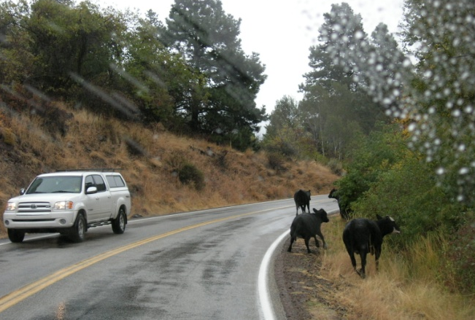
Solid yellow line on your side.
Passing is NOT ALLOWED.
Notes:
Passing is not allowed, but you may move to the opposite lane to avoid hitting the livestock.
What do you need to do before you make this move?

Slide 23
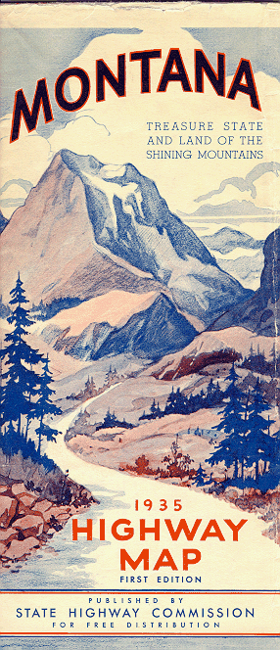
Let’s see what you know about signs,
lines and markings!

Slide 24
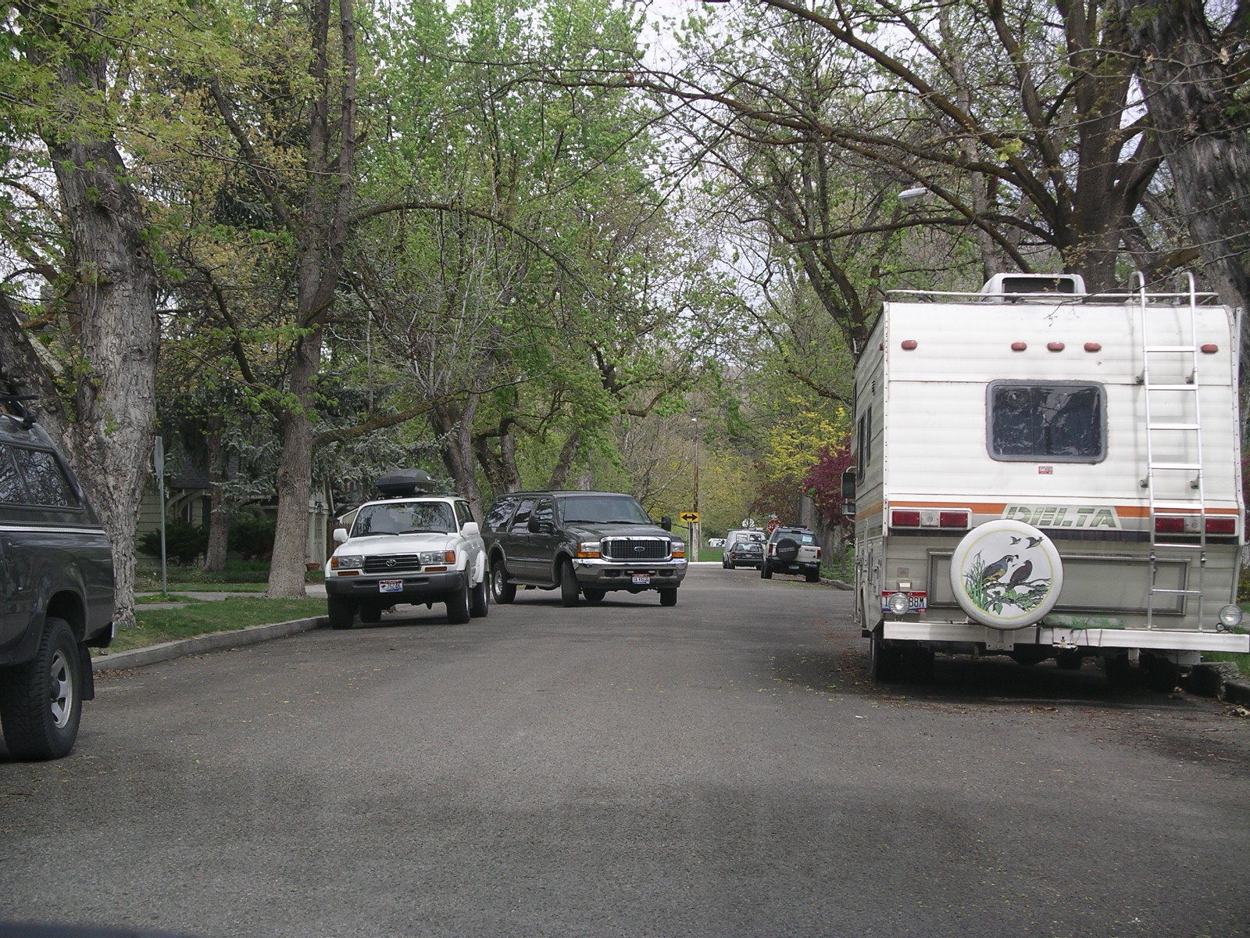
One-way or two-way?
Notes:
Is this a one-way or two-way street? What cues do you see to help you know this?

Slide 25
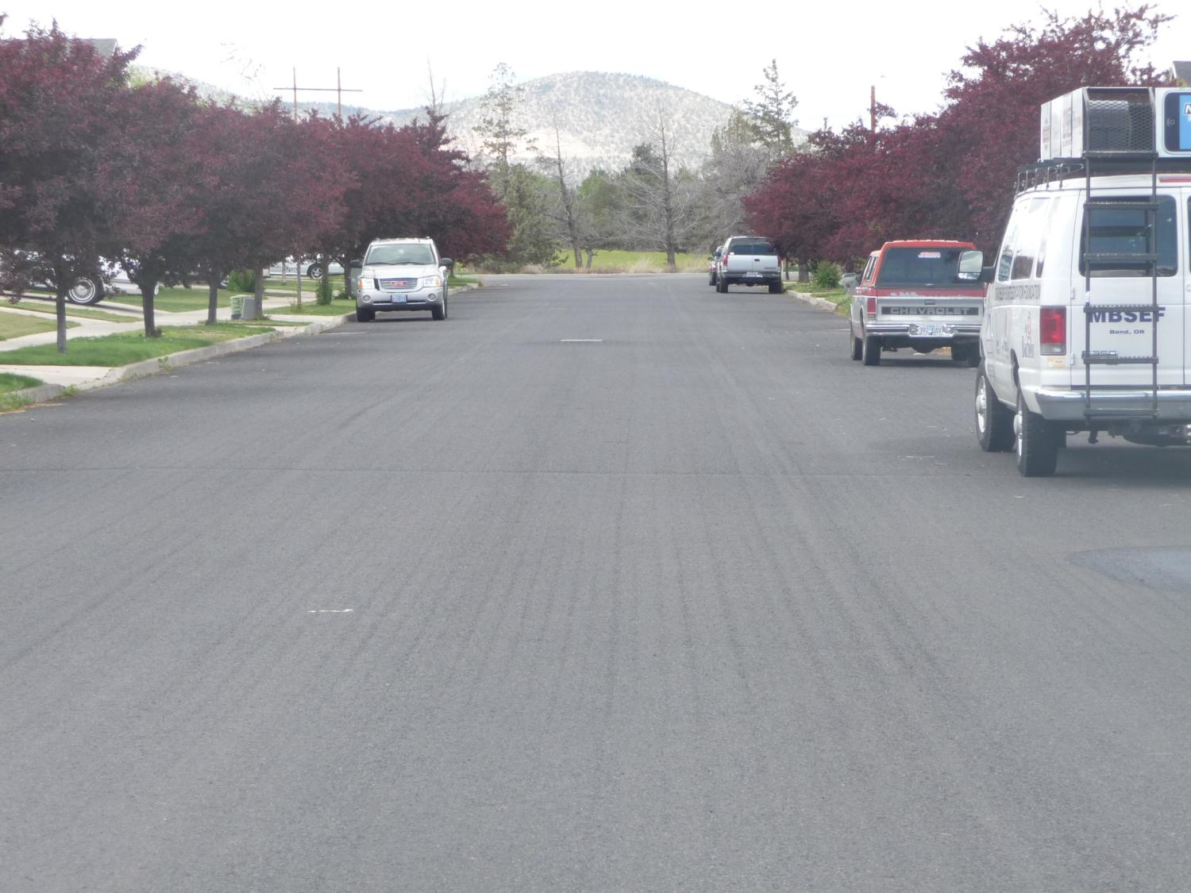
How many lanes?
What are they used for?
Notes:
4 lanes
2 driving lanes and 2 parking lanes.
Parking lanes are used for parking and beginning right turns.
Driving lanes are used for driving straight and beginning left turns.

Slide 26
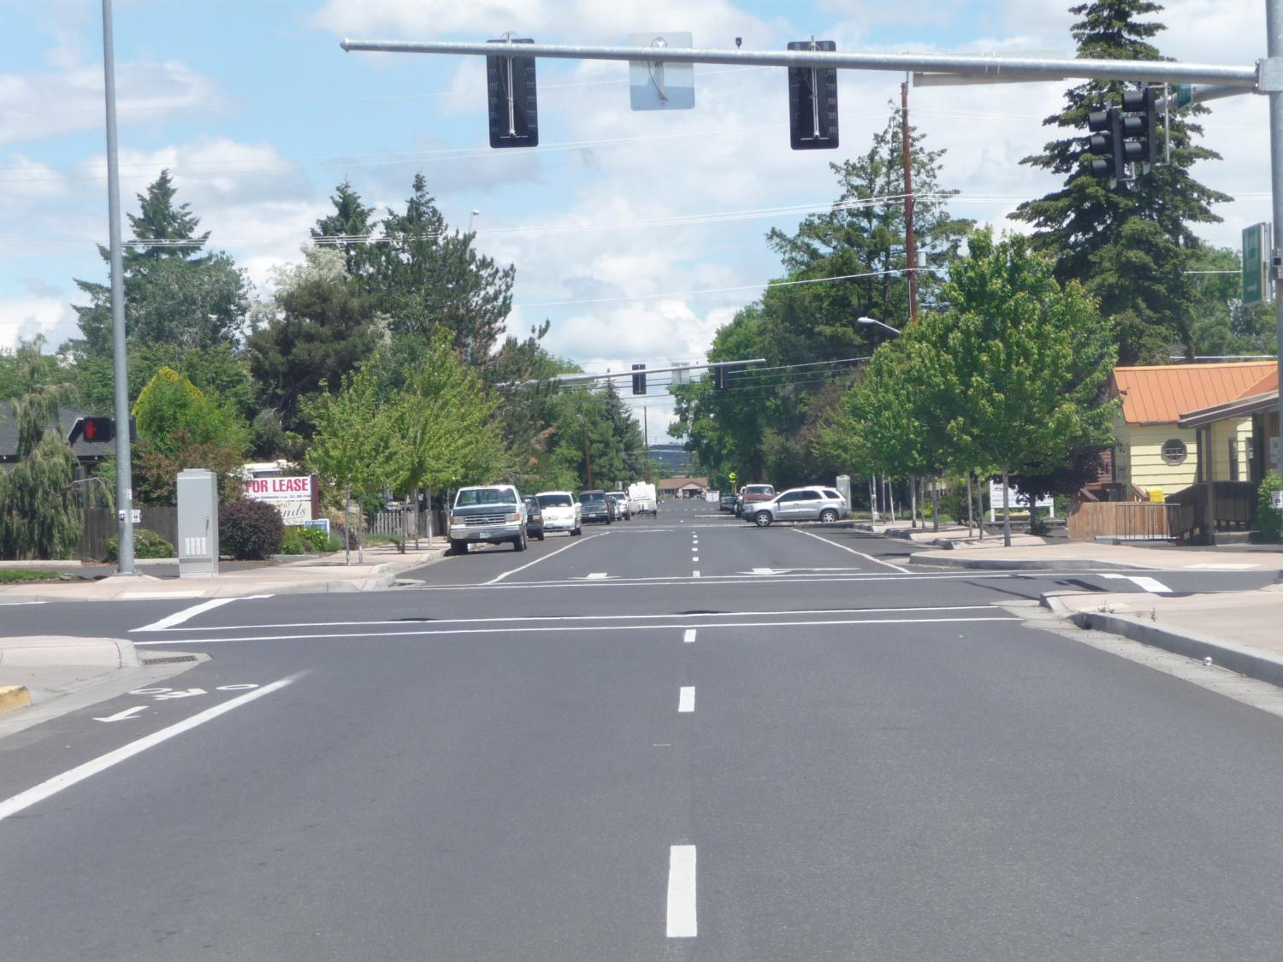
This is your view from the driver seat.
You have two really big problems!
What are they?
Notes:
Facing the wrong way on a one-way street!
And …

Slide 27
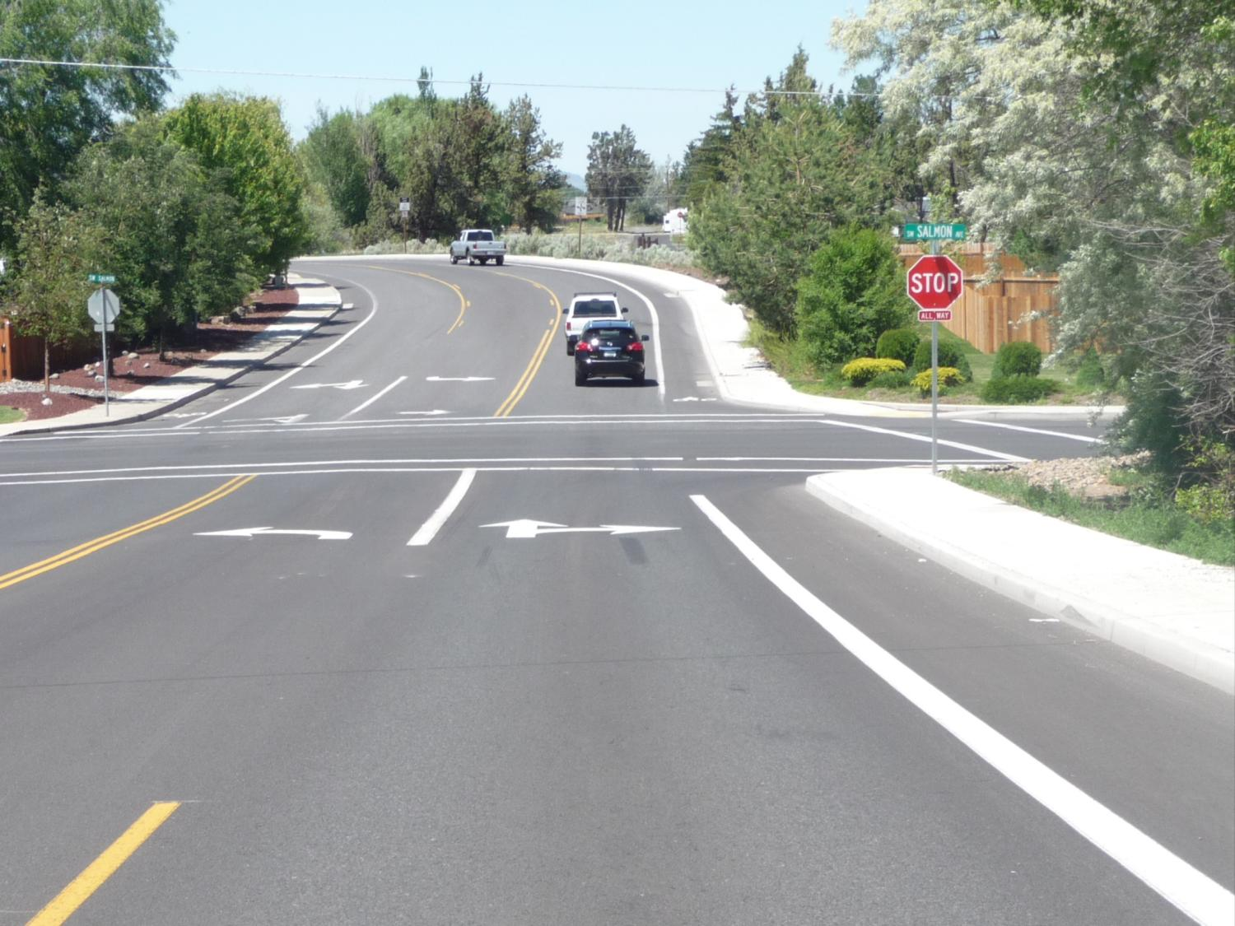
Where should you enter the turn lane?
Notes:
Between the yellow line and white line on the left
And what should you do before you enter the turn lane?

Slide 28
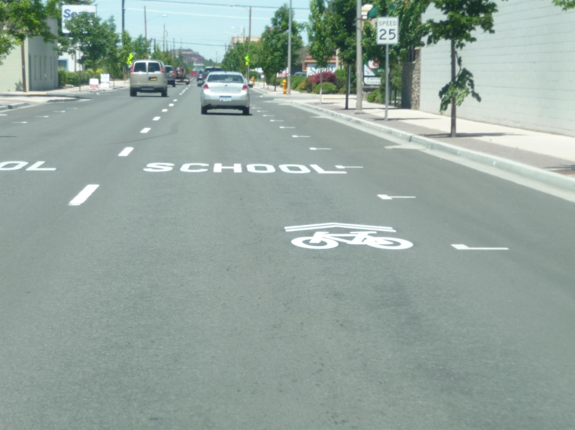
1.
3.
2.
4.
What do these markings tell you?
Notes:
Marks parking spaces
One way street
Entering school zone
Sharrow marking - vehicles and bicyclists share the same lane
This marking is placed in the center of a travel lane to indicate that a bicyclist may use the full lane.

Slide 29

Are you allowed to turn right and left across these lines?

Slide 30
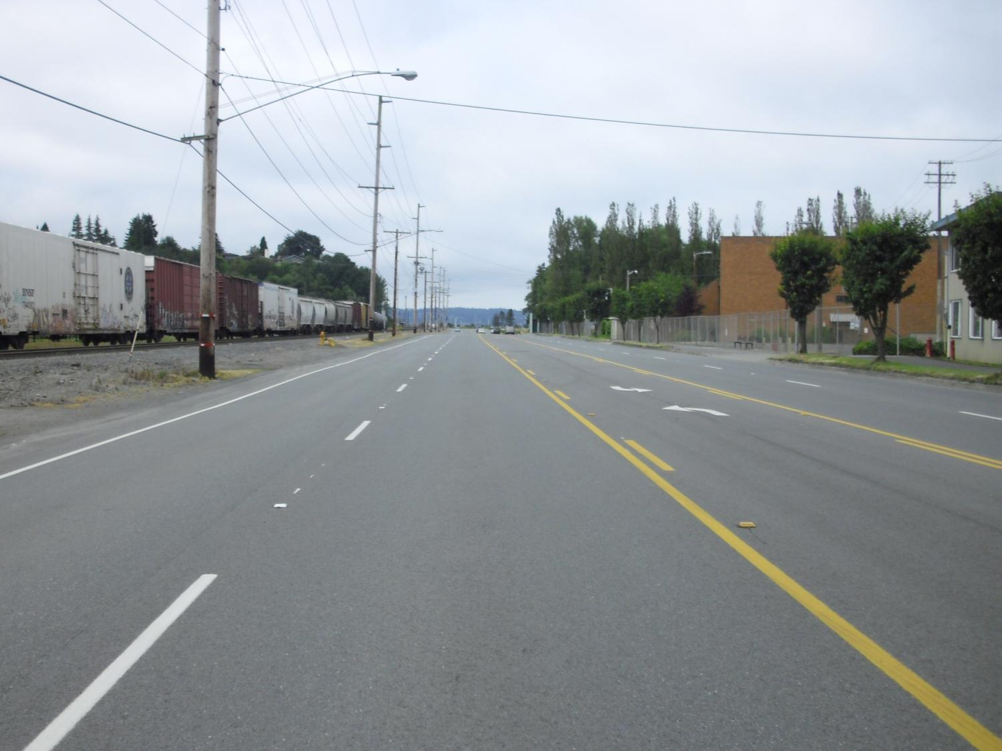
You are the driver. This is your view to the front.
What do these roadway markings tell you?
Notes:
You’re on the wrong side of the road – stay to the right of yellow lines!

Slide 31
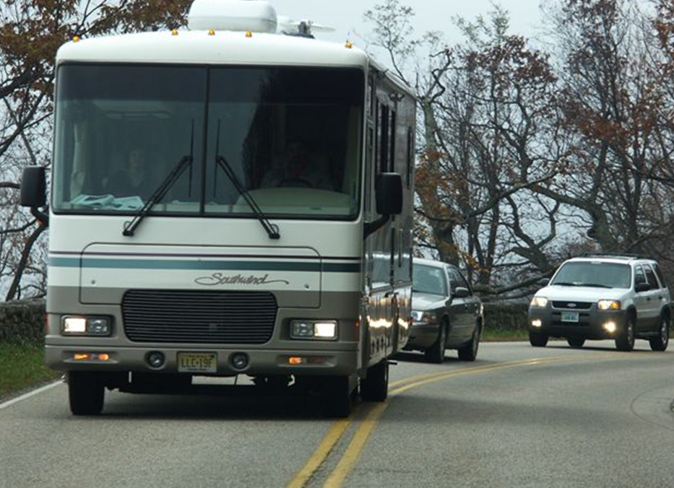
You’re in the white car. Can you pass the RV?
Photo courtesy of AAA Foundation
Notes:
Not a good idea, especially with the double yellow lines telling you not to pass.

Slide 32
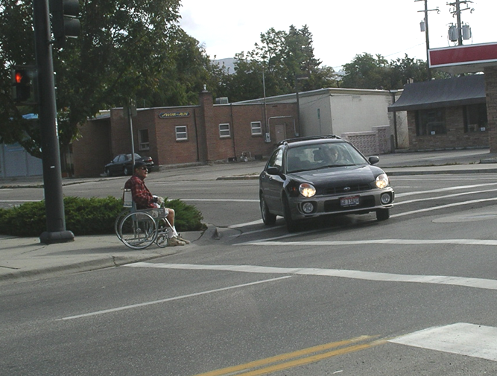
Who should yield – the man or the car?
Notes:
Technically, the person in the wheelchair must obey his traffic control signal. But, pedestrians always have the right of way.

Slide 33
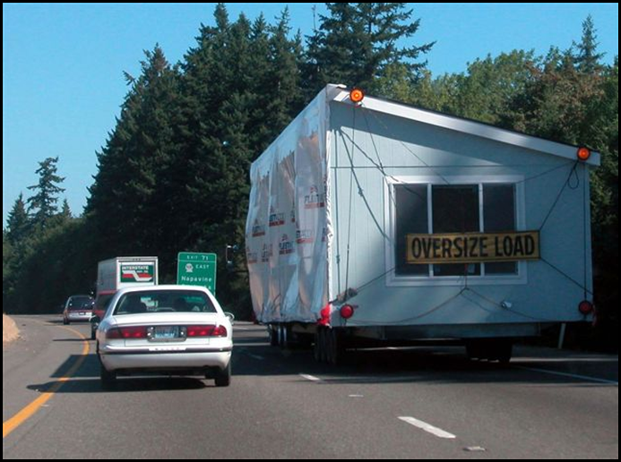
Is it safe and legal to pass the oversize load here?
Photo courtesy of AAA Foundation
Notes:
It is legal to pass this oversize load because we are on a freeway. Procedure should be to create space by moving close to the yellow line or lane position 2.

Slide 34
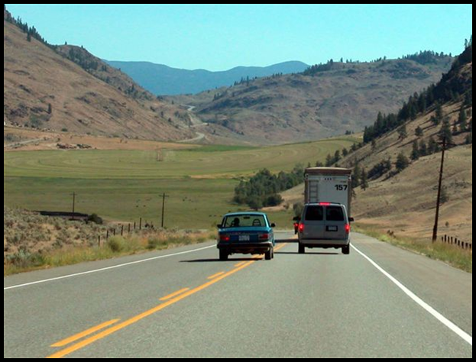
Is it safe and legal to pass here?
Photo courtesy of AAA Foundation
Notes:
The car is breaking the law by passing the truck on this blind curve. What should you do to create space in case he meets a car in the opposite direction?

Slide 35
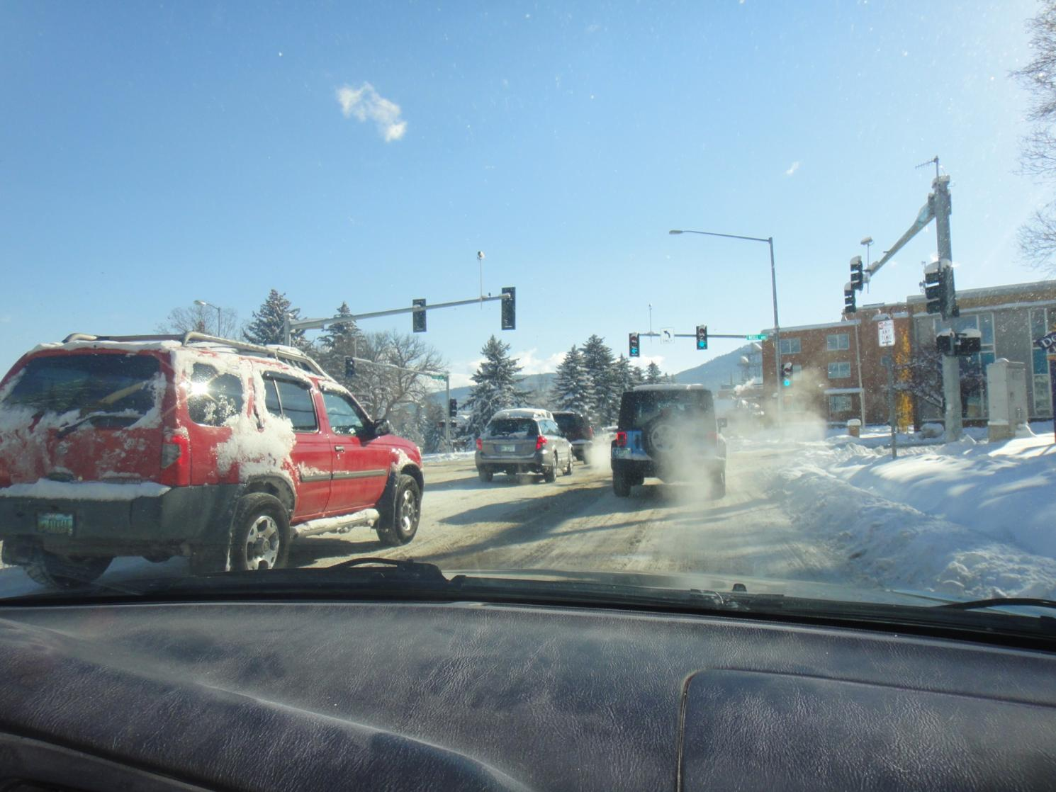
One-way or two-way?
How many lanes?
Notes:
Two-way with 4 lanes. What clues help you determine this information?

Slide 36
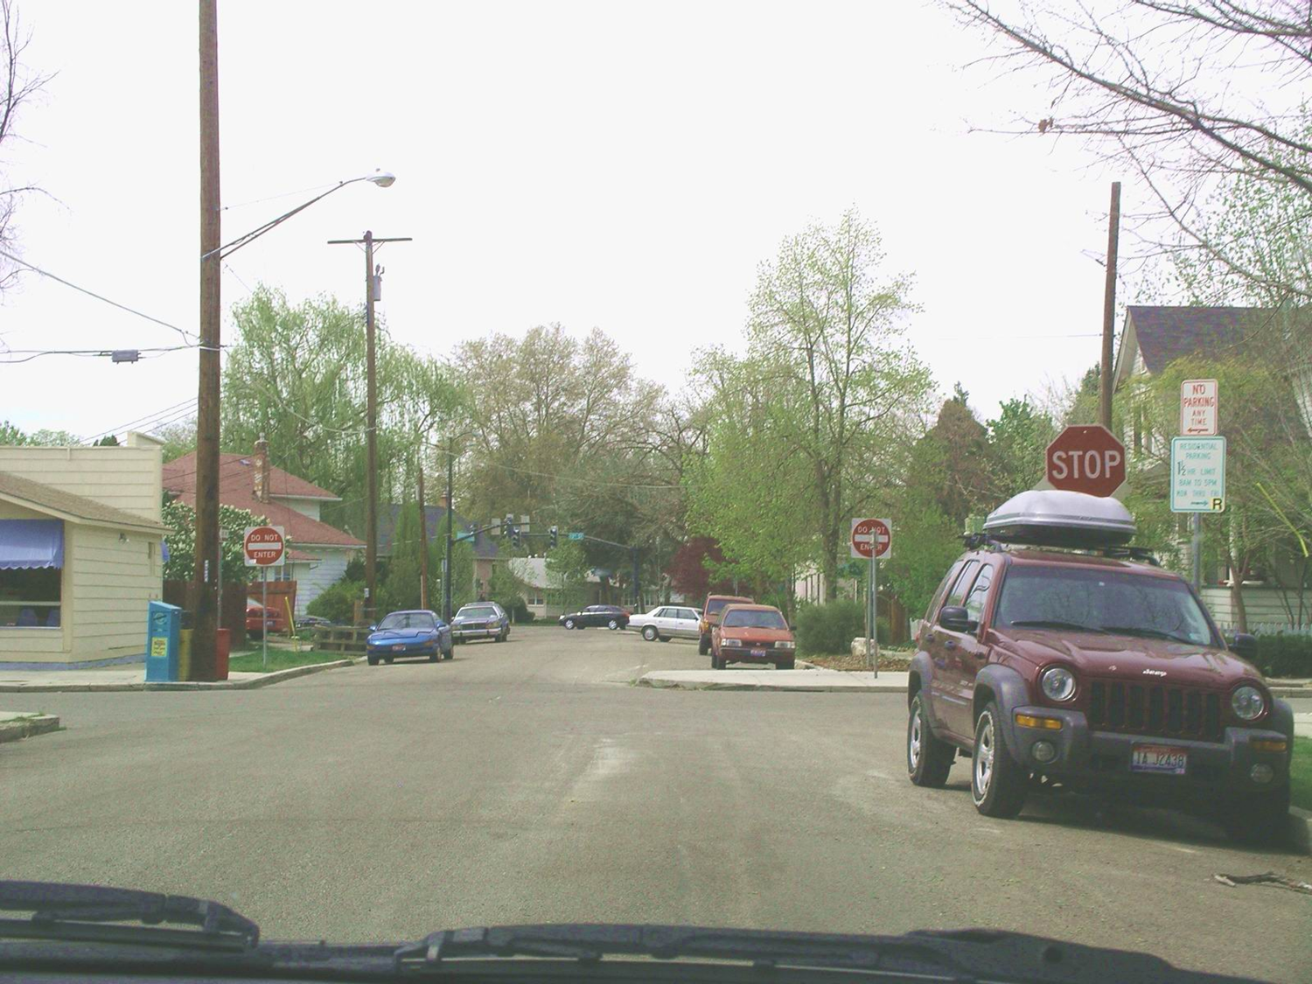
One-way or two-way? What’s the problem here?
Notes:
Obviously, the driver of this car doesn’t know how to legally park. He or she has caused some problems, especially for other drivers. The first is parking on the wrong of the street and the second is that the Yakima carrier could block the stop sign. Your clue that you are on a two-way street is the signage that is meant for you.

Slide 37
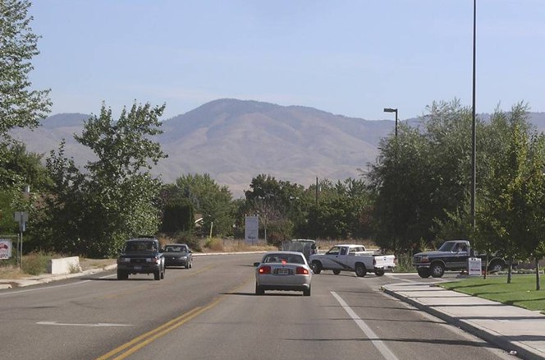
You are in the white truck.
What is the driver in the gray car doing? Why?
Notes:
Merging with traffic moving at 30 mph requires at least 6-7 seconds (one-block gap).
Merging with traffic moving at 55 mph requires at least a three-block gap.
Did the driver in the white truck have a safe gap for a right turn?

Slide 38
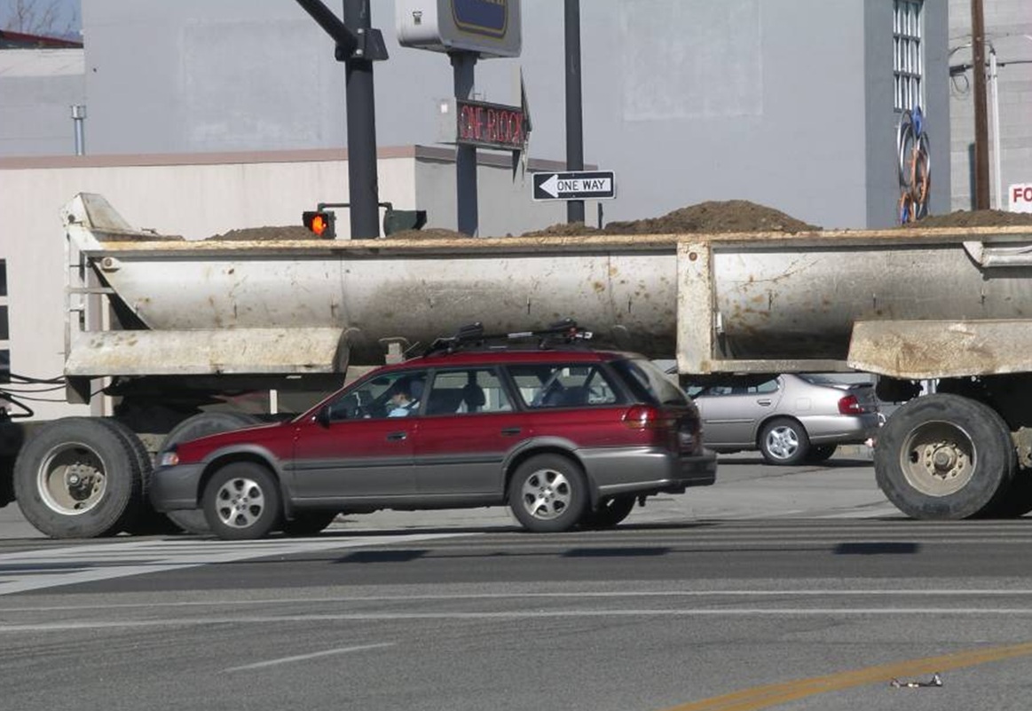
Can you turn right?
Notes:
What do you need to do to make your right turn?

Slide 39
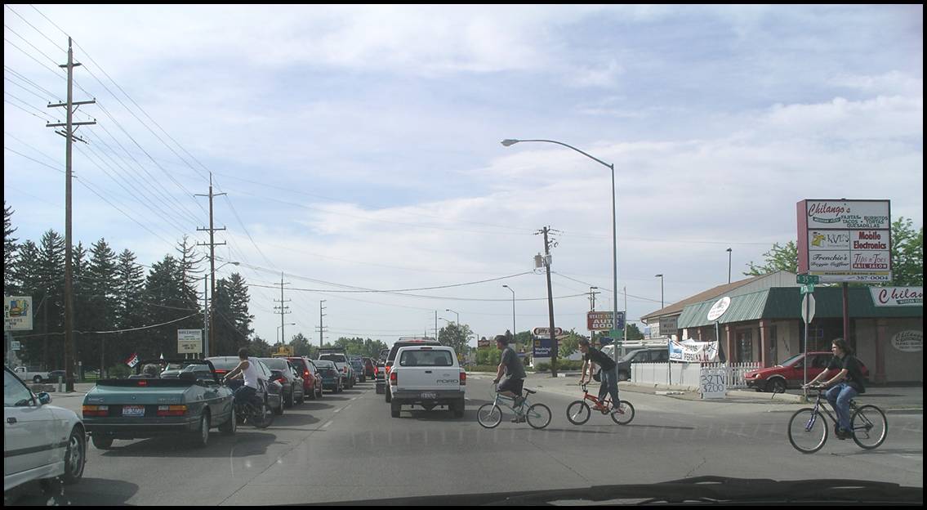
Scan your front zone.
What do you see and what are your options?
Notes:
Scan your front zone.
What do you see and what are your options?

Slide 40
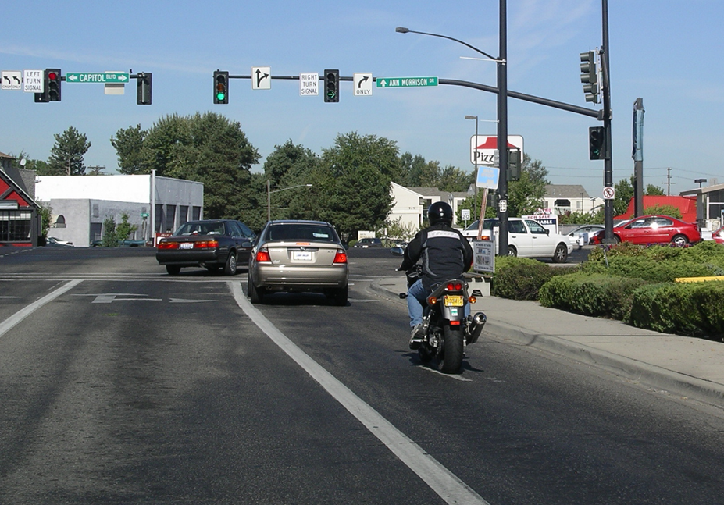
Can you turn right if you stay in this lane?
Notes:
What are you supposed to do in the far right lane?

Slide 41
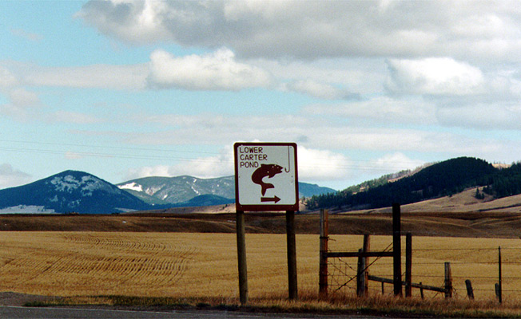
What does this sign tell you?
Notes:
Lower Carter Pond Fishing Access Site
9 miles northeast of Lewistown on Hwy 191

Slide 42

Montana Codes and Tribal Codes Regulate Traffic
Notes:
Under Montana law, motorists stopped for a traffic violation or involvement in a motor vehicle collision are required to show proof of insurance to law enforcement, in addition to displaying their driver license and vehicle registration.
Indians driving on reservation roads in Indian country follow tribal traffic codes which may not require a driver license and insurance. Consider inviting a tribal officer to discuss the traffic codes which apply in specific areas. The Tribal Council of the Confederated Salish and Kootenai Tribes adopted the Montana traffic laws in MCA Title 61.

Slide 43
Montana Driver Education and Training
Standards and Benchmarks
1. Laws and Highway System
  1.1. know the laws outlined in the Montana Driver's manual;
  1.2. understand the laws outlined in the Montana Driver's Manual; and
  1.3. consistently demonstrate knowledge and understanding by responsible adherence to highway transportation system traffic laws and control devices.
2. Responsibility
  2.1. recognize the importance of making safe and responsible decisions for owning and operating a motor vehicle;
  2.2 demonstrate the ability to make appropriate decisions while operating a motor vehicle;
  2.3. consistently display respect for other users of the highway transportation system; and
  2.4. develop positive habits and attitudes for responsible driving.
3. Visual Skills
  3.1. know proper visual skills for operating a motor vehicle;
  3.2. communicate and explain proper visual skills for operating a motor vehicle;
  3.3. demonstrate the use of proper visual skills for operating a motor vehicle; and
  3.4. develop habits and attitudes with regard to proper visual skills.
4. Vehicle Control
  4.1. demonstrate smooth, safe and efficient operation of a motor vehicle; and
  4.2. develop positive habits and attitudes relative to safe, efficient and smooth vehicle operation.
5. Communication
  5.1. consistently communicate driving intentions (i.e., use of lights, vehicle position, and personal signals);
  5.2. adjust driver behavior based on observation of the highway transportation system and other roadway users;
  5.3. adjust communication (i.e., use of lights, vehicle position, and personal signals) based on observation of the highway transportation system and other users; and
  5.4. develop positive habits and attitudes for effective communication.
6. Risk Management
  6.1. understand driver risk-management principles;
  6.2. demonstrate driver risk-management strategies; and
  6.3. develop positive habits and attitudes for effective driver risk-management.
7. Lifelong Learning
  7.1. identify and use a range of learning strategies required to acquire or retain knowledge, positive driving habits, and driving skills for lifelong learning;
  7.2. establish learning goals that are based on an understanding of one’s own current and future learning needs; and
  7.3. demonstrate knowledge and ability to make informed decisions required for positive driving habits, effective performance, and adaptation to change.
8. Driving Experience
  8.1. acquire at least the minimum number of BTW hours over at least the minimum number of days, as required by law, with a Montana-approved driver education teacher; and
  8.2. acquire additional behind-the-wheel driving experience with a parent or guardian’s assistance in a variety of driving situations (i.e., night, adverse weather, gravel road, etc.).
Notes:
Standards and Benchmarks: This is for your reference and not to be read to the class verbatim. Please review prior to the lesson so you are aware of what the student will be required to know at the end of the module.

